Slide 1

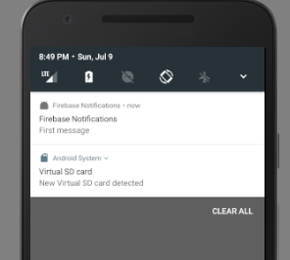

Notifications using Firebase

Slide 2
Import firebase messaging
dependencies { compile 'com.android.support:appcompat-v7:25.3.1' compile 'com.google.firebase:firebase-messaging:11.0.2'
}

Slide 3
Creating MyFirebaseMessagingService
public class MyFirebaseMessagingService extends FirebaseMessagingService { @Override public void onMessageReceived(RemoteMessage remoteMessage) { super.onMessageReceived(remoteMessage); String message = remoteMessage.getFrom(); Log.d("FirebaseNofifications", "Message Received: " + message); if (remoteMessage.getNotification().getBody() != null) { Log.d("FirebaseNofifications", "Notification body: " +
remoteMessage.getNotification().getBody()); } } }

Slide 4
Creating MyFirebaseInstanceIDService
public class MyFirebaseInstanceIDService extends FirebaseInstanceIdService { @Override public void onTokenRefresh() { super.onTokenRefresh(); String token = FirebaseInstanceId.getInstance().getToken(); Log.d("FirebaseNofifications", "Token: " +token); } }

Slide 5
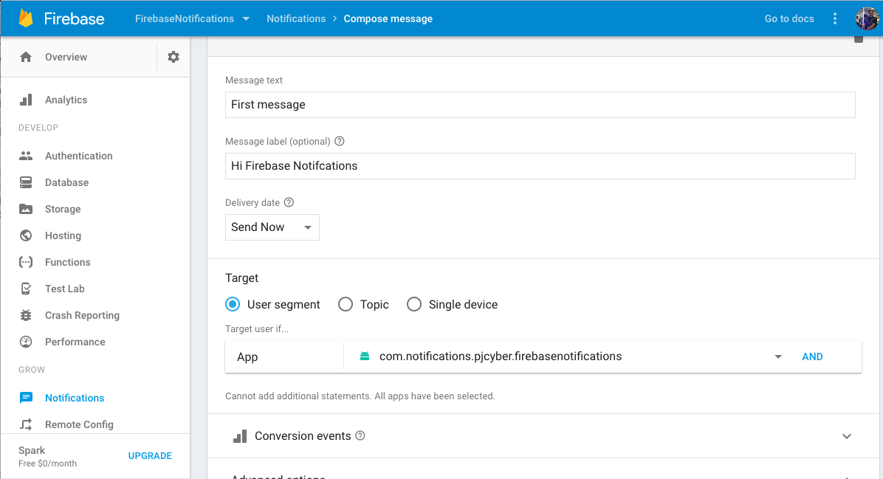
we can send our first message

Slide 6
Debugging messages

Slide 7
Showing notifications
private void showNotification(String title, String body) { Uri soundUri = RingtoneManager.getDefaultUri(RingtoneManager.TYPE_NOTIFICATION); Intent intent = new Intent(this, MainActivity.class); intent.setFlags(Intent.FLAG_ACTIVITY_CLEAR_TOP); PendingIntent pendingIntent = PendingIntent.getActivity(this, 0, intent, PendingIntent.FLAG_ONE_SHOT); NotificationCompat.Builder notification = new NotificationCompat.Builder(this) .setSmallIcon(R.mipmap.ic_launcher) .setContentTitle(title) .setContentText(body) .setAutoCancel(true) .setSound(soundUri) .setContentIntent(pendingIntent); NotificationManager notificationManager = (NotificationManager) getSystemService(Context.NOTIFICATION_SERVICE); notificationManager.notify(0, notification.build()); }

Slide 8
Debugging messages

